Slide 1
DEEP LEARNING

Slide 2
What is AI?
Artificial intelligence (AI) is a wide-ranging branch of computer science concerned with building smart machines capable of performing tasks that typically require human intelligence.

Slide 3
WHAT ARE THE FOUR TYPES OF ARTIFICIAL INTELLIGENCE?
Reactive Machines
Limited Memory
Theory of Mind
Self-Awareness

Slide 4
WHAT ARE EXAMPLES OF ARTIFICIAL INTELLIGENCE?
Siri, Alexa and other smart assistants
Self-driving cars
Robo-advisors
Conversational bots
Email spam filters
Netflix's recommendations

Slide 5
Learning processes.
This aspect of AI programming focuses on acquiring data and creating rules for how to turn the data into actionable information.
The rules, which are called algorithms, provide computing devices with step-by-step instructions for how to complete a specific task.

Slide 6
Reasoning processes. This aspect of AI programming focuses on choosing the right algorithm to reach a desired outcome.
Self-correction processes. This aspect of AI programming is designed to continually fine-tune algorithms and ensure they provide the most accurate results possible.

Slide 7
Strong AI vs. weak AI
Weak AI, also known as narrow AI, is an AI system that is designed and trained to complete a specific task. Industrial robots and virtual personal assistants, such as Apple's Siri, use weak AI.
Strong AI, also known as artificial general intelligence (AGI), describes programming that can replicate the cognitive abilities of the human brain.

Slide 8
What are the 4 types of artificial intelligence?
Reactive machines. These AI systems have no memory and are task specific.
Limited memory. These AI systems have memory, so they can use past experiences to inform future decisions.
Theory of mind. Theory of mind is a psychology term. When applied to AI, it means that the system would have the social intelligence to understand emotions.
Self-awareness. In this category, AI systems have a sense of self, which gives them consciousness.

Slide 9
What are examples of AI technology and how is it used today?
Automation. When paired with AI technologies, automation tools can expand the volume and types of tasks performed.
Machine learning. This is the science of getting a computer to act without programming.
  Supervised learning. Data sets are labeled so that patterns can be detected and used to label new data sets.
  Unsupervised learning. Data sets aren't labeled and are sorted according to similarities or differences.
  Reinforcement learning. Data sets aren't labeled but, after performing an action or several actions, the AI system is given feedback.

Slide 10
Machine vision. This technology gives a machine the ability to see. Machine vision captures and analyzes visual information using a camera, analog-to-digital conversion and digital signal processing.
Natural language processing (NLP). This is the processing of human language by a computer program. One of the older and best-known examples of NLP is spam detection, which looks at the subject line and text of an email and decides if it's junk.

Slide 11
Robotics. This field of engineering focuses on the design and manufacturing of robots. Robots are often used to perform tasks that are difficult for humans to perform or perform consistently.
Self-driving cars. Autonomous vehicles use a combination of computer vision, image recognition and deep learning to build automated skill at piloting a vehicle while staying in a given lane and avoiding unexpected obstructions, such as pedestrians.

Slide 12
What are the applications of AI?
AI in healthcare. The biggest bets are on improving patient outcomes and reducing costs. Companies are applying machine learning to make better and faster diagnoses than humans.
AI in business. Machine learning algorithms are being integrated into analytics and customer relationship management (CRM) platforms to uncover information on how to better serve customers.

Slide 13
AI in education. AI can automate grading, giving educators more time.
AI in finance. AI in personal finance applications, such as Intuit Mint or TurboTax, is disrupting financial institutions.
AI in law. The discovery process -- sifting through documents -- in law is often overwhelming for humans. Using AI to help automate the legal industry's labor-intensive processes is saving time and improving client service.

Slide 14
AI in manufacturing. Manufacturing has been at the forefront of incorporating robots into the workflow.
For example, the industrial robots that were at one time programmed to perform single tasks and separated from human workers, increasingly function as cobots:
Smaller, multitasking robots that collaborate with humans and take on responsibility for more parts of the job in warehouses, factory floors and other workspaces.

Slide 15
AI in banking. Banks are successfully employing chatbots to make their customers aware of services and offerings and to handle transactions that don't require human intervention.
AI virtual assistants are being used to improve and cut the costs of compliance with banking regulations.
AI in transportation. In addition to AI's fundamental role in operating autonomous vehicles, AI technologies are used in transportation to manage traffic, predict flight delays, and make ocean shipping safer and more efficient.
Security. AI and machine learning are at the top of the buzzword list security vendors use today to differentiate their offerings. Those terms also represent truly viable technologies.

Slide 16
Augmented intelligence vs. artificial intelligence
Augmented intelligence. Some researchers and marketers hope the label augmented intelligence, which has a more neutral connotation, will help people understand that most implementations of AI will be weak and simply improve products and services.
Artificial intelligence. True AI, or artificial general intelligence, is closely associated with the concept of the technological singularity -- a future ruled by an artificial superintelligence that far surpasses the human brain's ability to understand it or how it is shaping our reality.

Slide 17
Artificial neuron
An artificial neuron is a digital construct that seeks to simulate the behavior of a biological neuron in the brain.
Artificial neurons are typically used to make up an artificial neural network – these technologies are modeled after human brain activity.

Slide 18
Understanding single layer Perceptron and difference between Single Layer vs Multilayer Perceptron
Single layer perceptron is a simple Neural Network which contains only one layer.
The single layer computation of perceptron is the calculation of sum of input vector with the value multiplied by corresponding vector weight.

Slide 19
The perceptron consists of 4 parts.
Input values or One input layer
Weights and Bias
Net sum
Activation Function

Slide 20
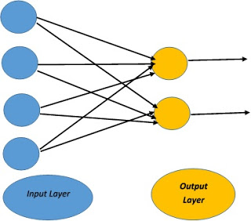
Single-layer Perceptron
Single Layer Perceptron has just two layers of input and output. It only has single layer hence the name single layer perceptron. It does not contain Hidden Layers as that of Multilayer perceptron.

Slide 21
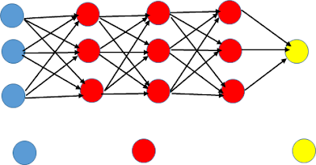
Multi-Layer Perceptron (MLP)
A multilayer perceptron is a type of feed-forward artificial neural network that generates a set of outputs from a set of inputs.

Slide 22
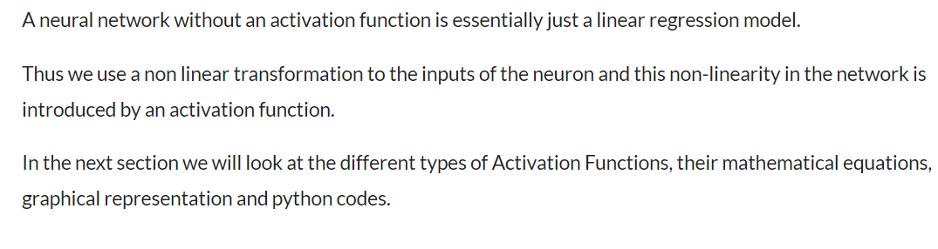
What is activation function and different types of activation functions?

Slide 23
Back Propagation and Gradient Descent Optimizers
Gradient Descent is an optimization algorithm that finds the set of input variables for a target function that results in a minimum value of the target function, called the minimum of the function.
Derivative: Slope or curvature of a target function with respect to specific input values to the function.
Gradient: Vector of partial derivatives of a target function with respect to input variables.
The gradient descent algorithm requires the calculation of the gradient of the target function with respect to the specific values of the input values.

Slide 24
A step size is used to scale the gradient and control how much to change each input variable with respect to the gradient.
Step Size: Learning rate or alpha, a hyperparameter used to control how much to change each input variable with respect to the gradient.
Stochastic Gradient Descent: Extension of the gradient descent optimization algorithm for minimizing a loss function of a predictive model on a training dataset.
Loss function: target function that is being minimized.
Model parameters: input parameters to the loss function that are being optimized.

Slide 25
Vanishing Gradient and Exploding Gradient Problems
Vanishing –
As the backpropagation algorithm advances downwards(or backward) from the output layer towards the input layer, the gradients often get smaller and smaller and approach zero which eventually leaves the weights of the initial or lower layers nearly unchanged. As a result, the gradient descent never converges to the optimum. This is known as the vanishing gradients problem.

Slide 26
Exploding –
On the contrary, in some cases, the gradients keep on getting larger and larger as the backpropagation algorithm progresses. This, in turn, causes very large weight updates and causes the gradient descent to diverge. This is known as the exploding gradients problem.
Certain activation functions, like the logistic function (sigmoid), have a very huge difference between the variance of their inputs and the outputs.
In simpler words, they shrink and transform a larger input space into a smaller output space that lies between the range of [0,1].

Slide 27
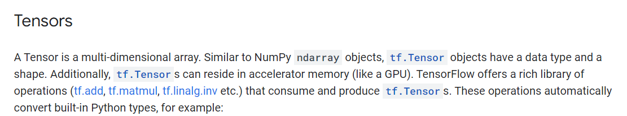
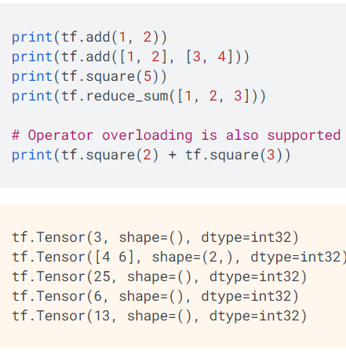
What are Tensors and TensorFlow basic operations

Slide 28
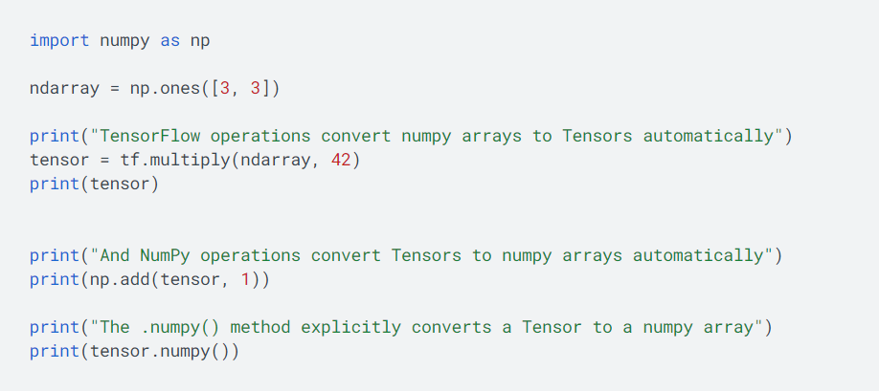
NumPy Compatibility

Slide 29
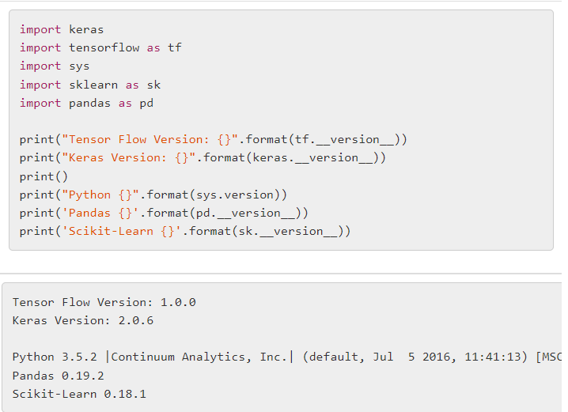
Keras basic operations

Slide 30
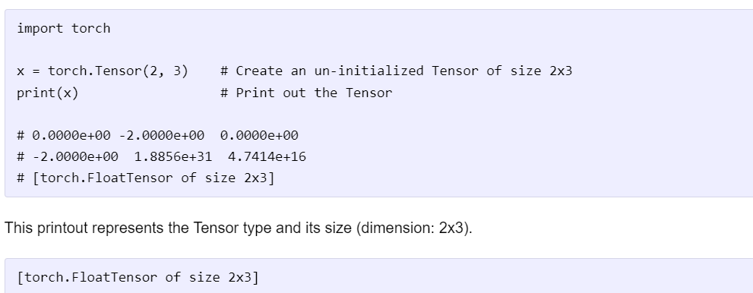
Pytorch basic operations

Slide 31
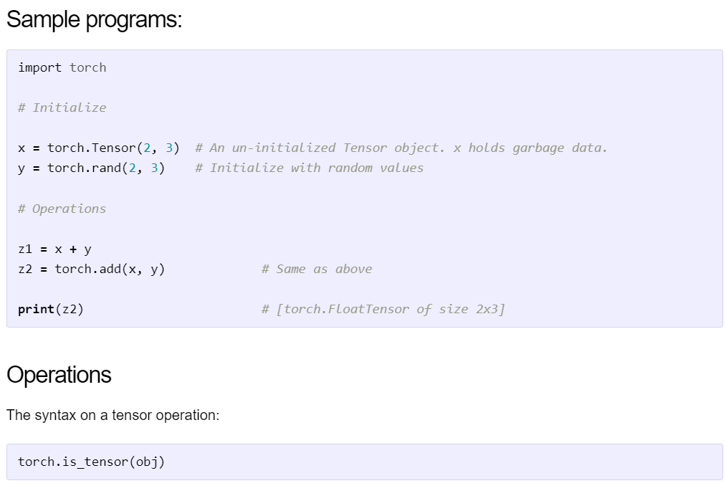

Slide 32
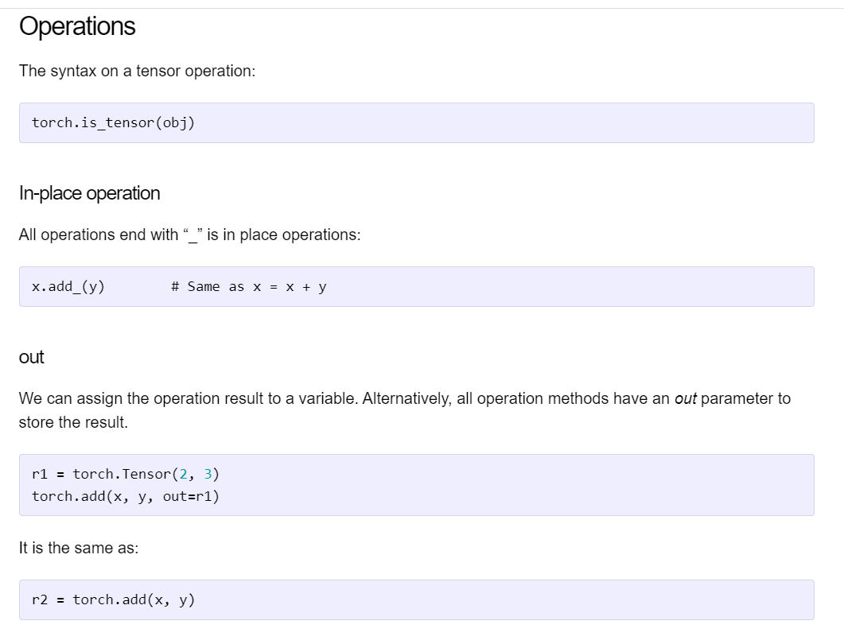

Slide 33
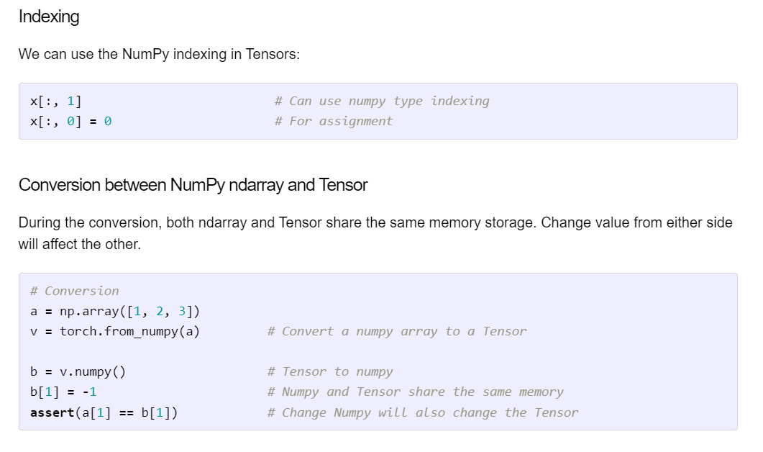
Applied Text Mining in Python

Slide 34
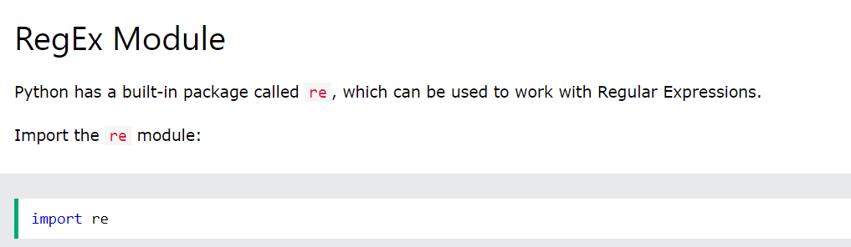
Regular Expressions

Slide 35
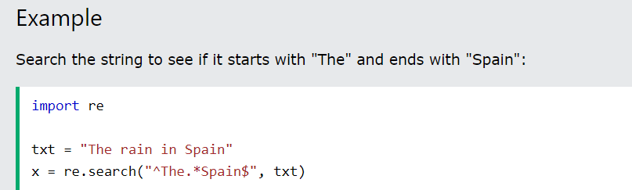
RegEx in Python
When you have imported the re module, you can start using regular expressions:

Slide 36
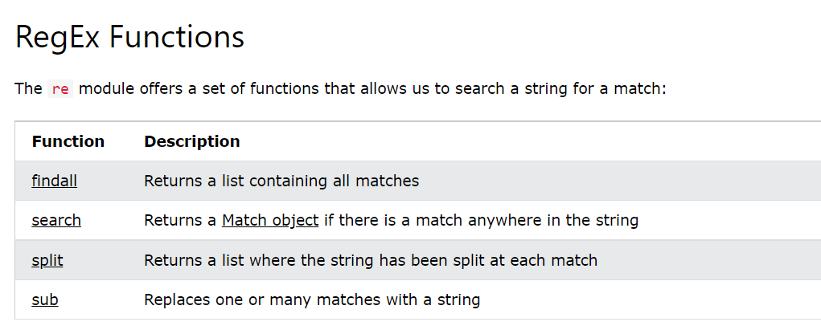

Slide 37
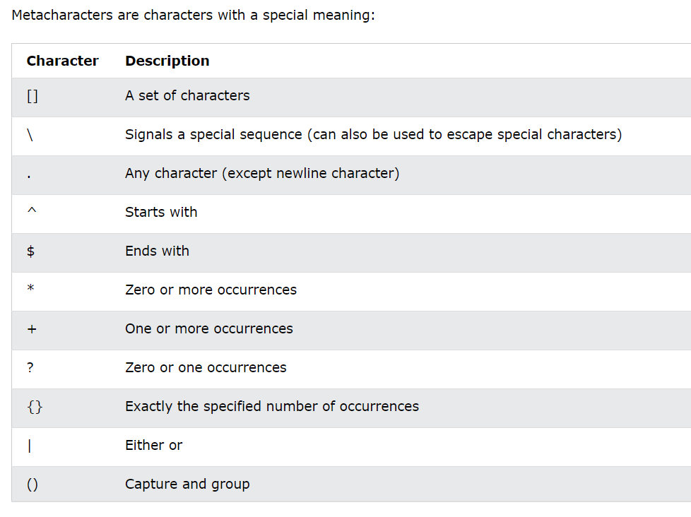

Slide 38
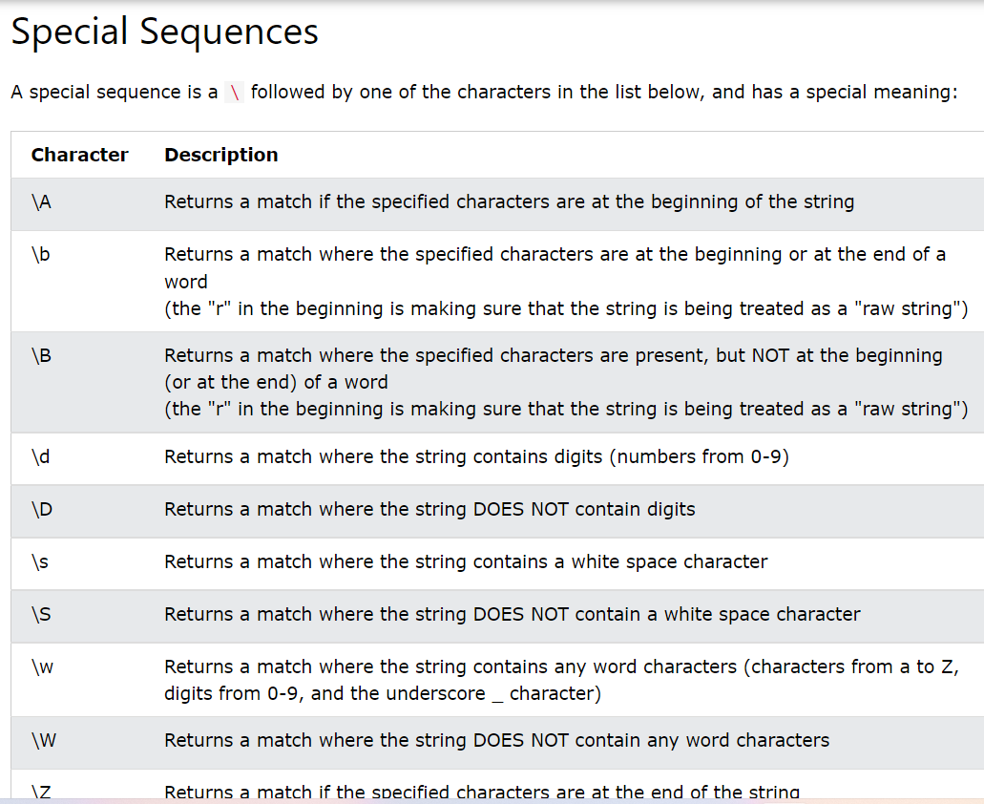

Slide 39
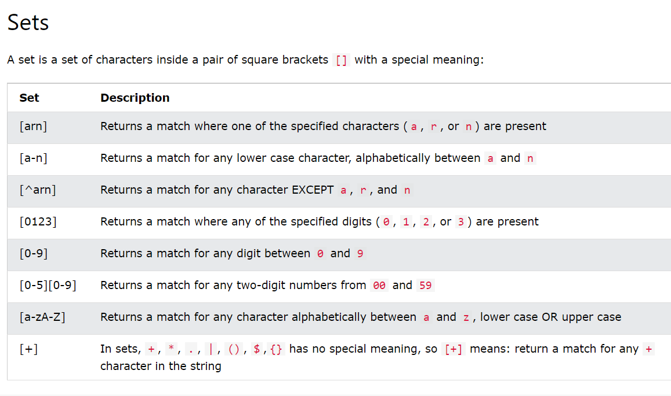

Slide 40
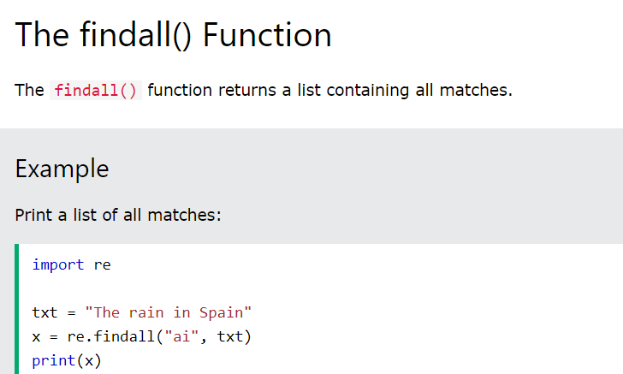

Slide 41
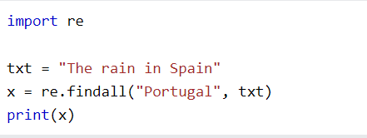

Slide 42
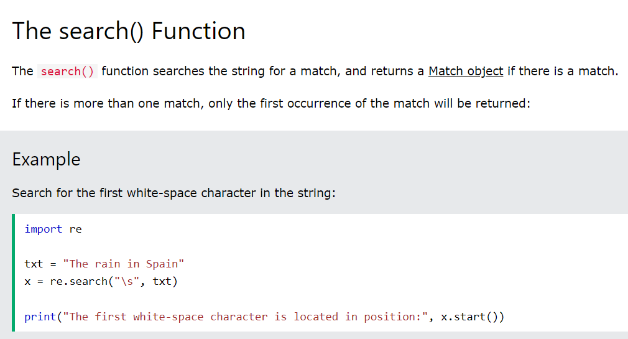

Slide 43
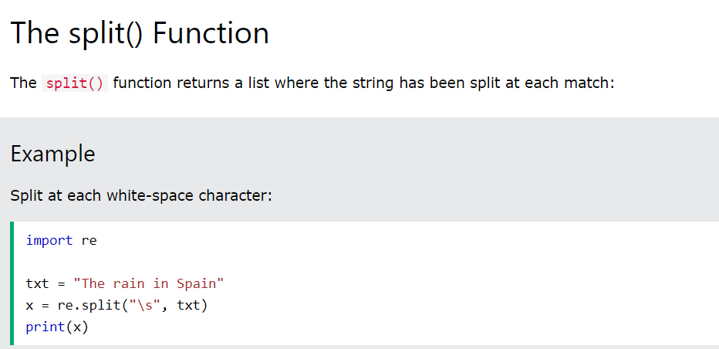

Slide 44
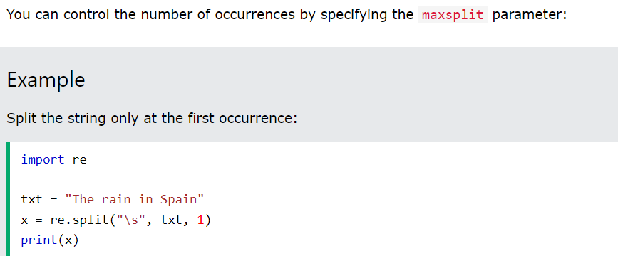

Slide 45
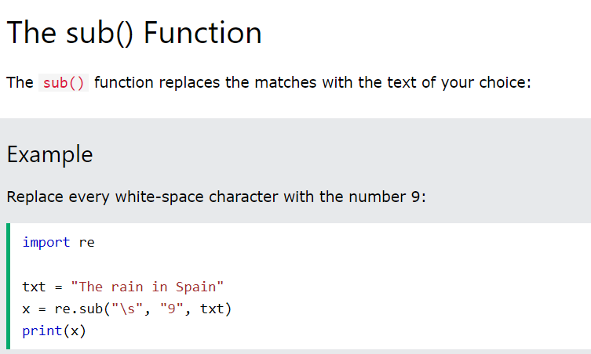

Slide 46
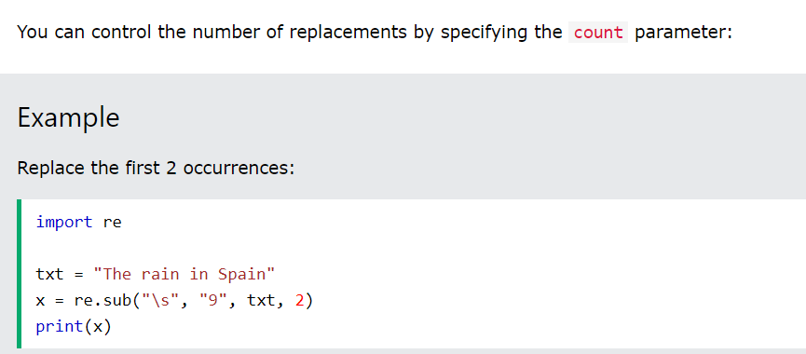

Slide 47



Slide 48
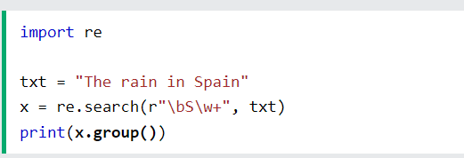

Slide 49
Basic Natural Language Processing
The following features make Python different from other languages −
Python is interpreted − We do not need to compile our Python program before executing it because the interpreter processes Python at runtime.
Interactive − We can directly interact with the interpreter to write our Python programs.
Object-oriented − Python is object-oriented in nature and it makes this language easier to write programs because with the help of this technique of programming it encapsulates code within objects.
Beginner can easily learn − Python is also called beginner’s language because it is very easy to understand, and it supports the development of a wide range of applications.

Slide 50
Getting Started with NLTK
We will be using Python library NLTK (Natural Language Toolkit) for doing text analysis in English Language.
The Natural language toolkit (NLTK) is a collection of Python libraries designed especially for identifying and tag parts of speech found in the text of natural language like English.

Slide 51
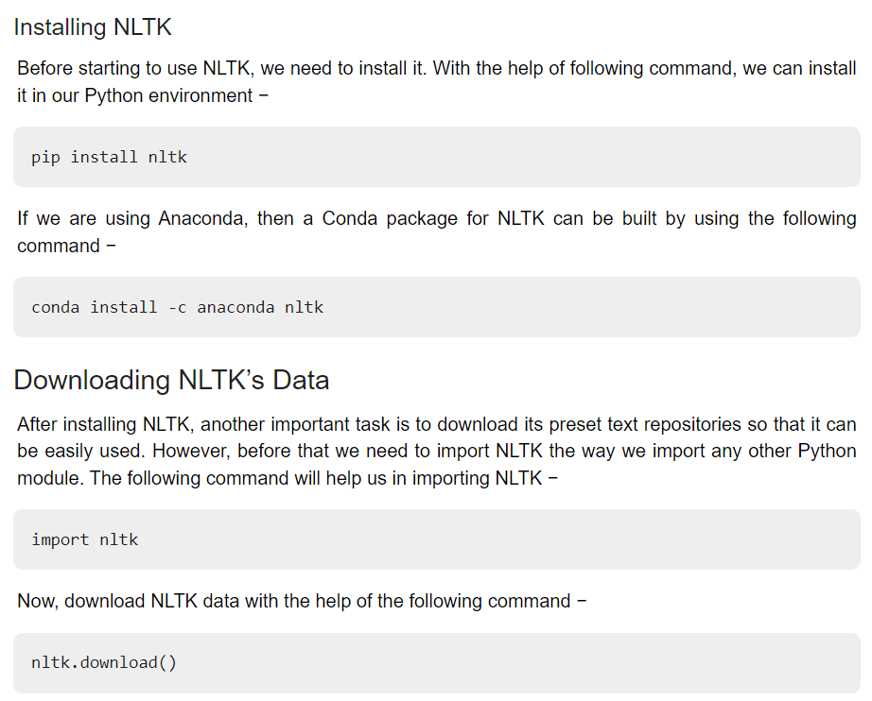

Slide 52
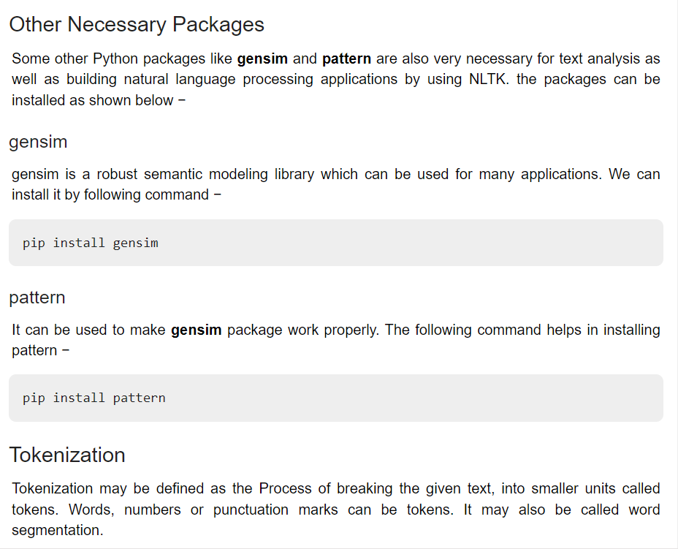

Slide 53
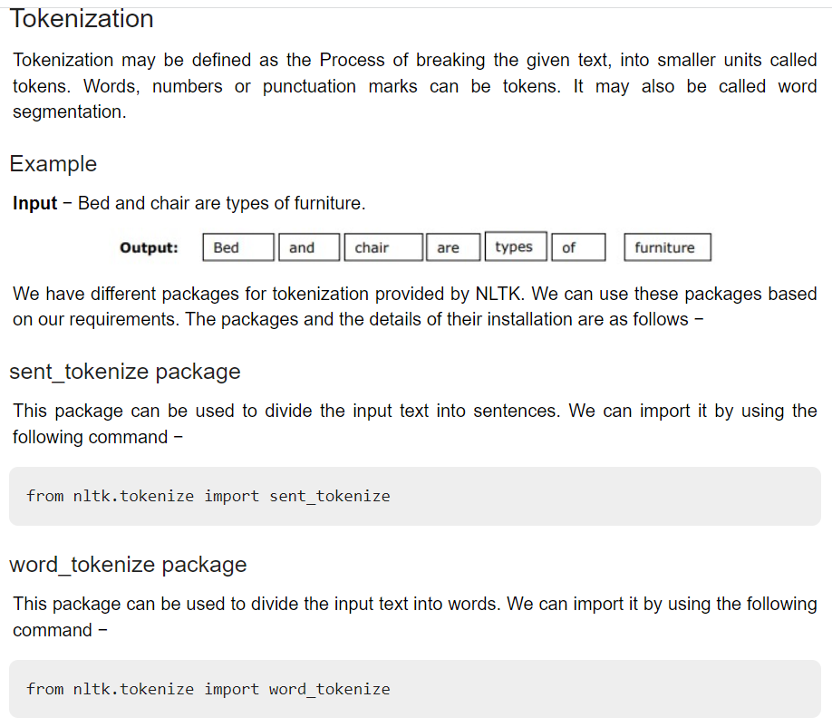

Slide 54
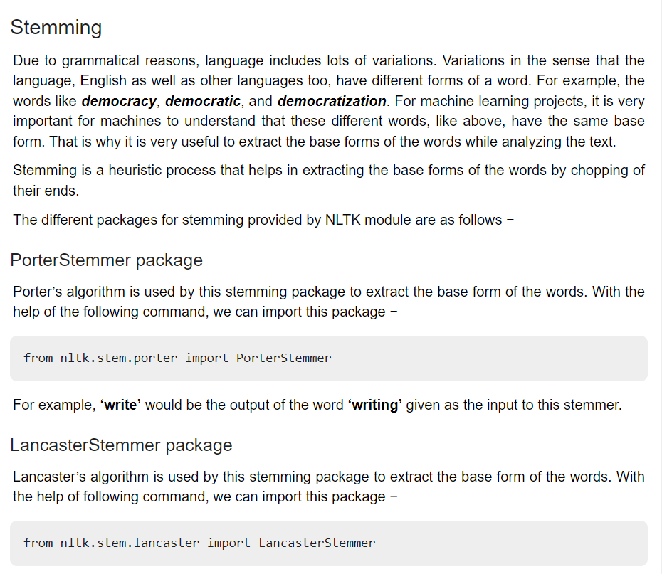

Slide 55
Advanced NLP tasks with NLTK
Python NLTK (natural language toolkit) sentiment analysis tutorial. Learn how to create and develop sentiment analysis using Python.
Natural Language Processing (NLP), the basics of NLP with sample codes and then dive into Natural Language Toolkit (NLTK) library to show how they simplify the NLP related tasks.

Slide 56
Advanced NLP tasks with NLTK
Natural Language Processing (NLP), broadly defined as the automatic manipulation of natural language, like speech and text, by software.

Slide 57
Text Classification
Text classification is one of the important task in supervised machine learning (ML).
It is a process of assigning tags/categories to documents helping us to automatically & quickly structure and analyze text in a cost-effective manner.

Slide 58
